Slide 1

Team
Abdullah Basit | 20I-0623
Muhammad Abubakar Siddique | 20F-0101
Areeba Rasheed | 19F-0238
Supervisor
Mr. Usman Ghous

Slide 2
Project Title: Smart Surveillance System (SSS)

Slide 3
Outline (FYP Report v 1.0)
Introduction
Features
Modules
Use Case Diagram
Class Diagram
Domain Model
Data Flow Diagram
Activity Diagram
Sequence Diagram
System Sequence Diagram
Component Diagram
ER Diagram for Databases
High Level Diagram
Committed Use Cases for next evaluation

Slide 4
Project Introduction
SSS is a pioneering solution addressing surveillance gaps in university CCTV systems. It integrates facial recognition, computer vision, and behavior analysis for comprehensive monitoring. By proactively identifying and tracking specific behaviors, such as smoking or fighting, it overcomes human limitations in overseeing multiple cameras, ensuring continuous monitoring and precise risk management.

Slide 5





High Level Features
Dashboard Overview
Live Video Feeds
A centralized web based dashboard displaying real-time data, alerts, and system status, allowing for a quick overview of the entire surveillance operation.
Access to live camera feeds with the ability to switch views, zoom, and track individuals using displayed ID’s in real-time across different cameras for detailed monitoring.
Activity Logs and Analytics
Alerts and Notifications Panel
Visual representation of data analytics and activity logs, including graphs and charts for easy interpretation of occurrences of behaviors.
A dedicated tab on the web based application for notifications and real-time alerts that require immediate attention.
Search and Filter Operation
Comprehensive search capability allows data querying by roll number, violation type, location, or time, with robust sorting and filtering options.

Slide 6


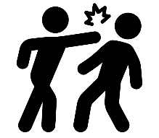




Modules
Facial Recognition Module
Smoking Behavior Detection Module
Identifies individuals in real-time for enhanced security and tracking.
Detect instances of smoking within the university to ensure the implementation of facility policies and health regulations
Fighting Behavior Detection Module
Littering Behavior Detection Module
Identify physical fights to maintain safety, and security with in facility.
Detect littering within the facility by detecting the dumping action to ensure a hygienic environment
Time and Location Logging Module
Data, Reporting, and Alert System
Real-time individual tracking through live camera feeds, recording location by camera name and timestamp for easy retrieval upon alerts.
Database records individual’s location and timestamp on occurrence of incidents of smoking, fighting, and littering, triggering alerts in the web application.

Slide 7
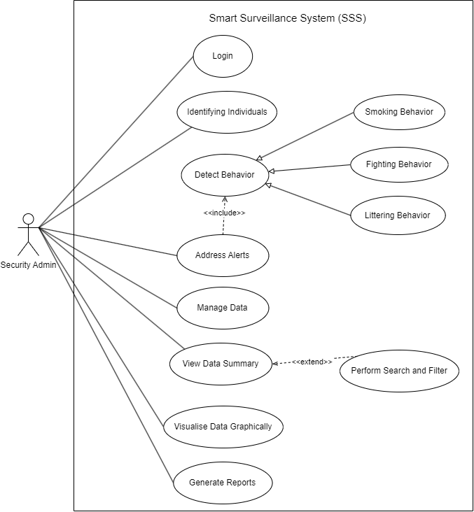
Use Case Diagram
Notes:
Generalization: smoking behavior (child inherits) and adds to parent detect behavior
Include: included use case detect behavior never stands alone, it occurs because address alert is a greater significant use case
Extend: base can stand alone (view data) but extension can be done on its behavior under certain conditions by another use case (search and filter)

Slide 8
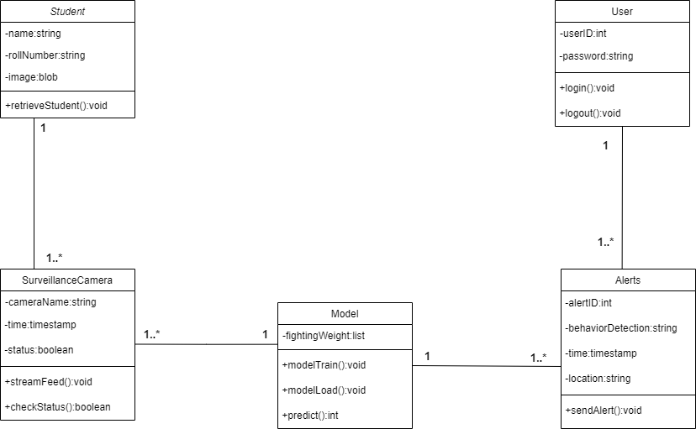
Class diagram
Notes:
Class diagram isn't applicable as such but for more better view/understanding of the system
Represents a blueprint for creating objects
Attributes: Represent the data fields or properties of a class
Methods: Represent the operations or functions that can be performed by objects of the class.

Slide 9
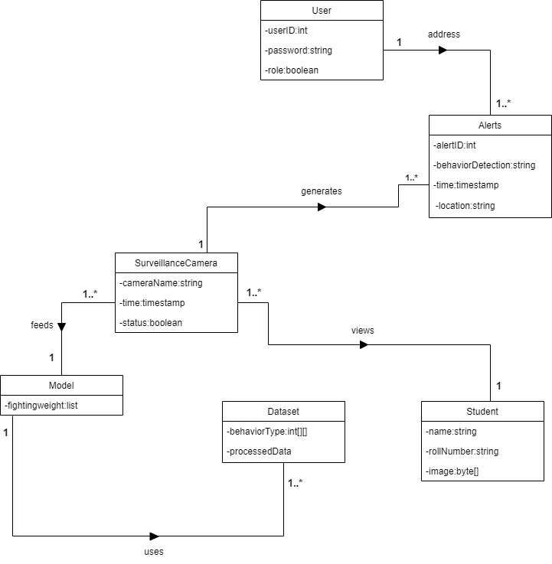
Domain Model
Notes:
Domain models are more abstract and conceptual, capturing the fundamental concepts, entities, and relationships within the problem domain.
In simple terms, a class diagram is about how the pieces of a software system fit together, like building blocks, while a domain model diagram is more about the real-world concepts and relationships that the system deals with, before any technical details are considered.

Slide 10
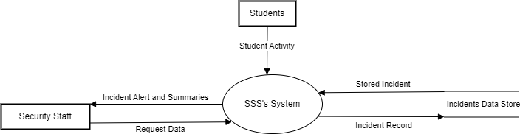
Data Flow Diagram Level 0
Notes:
DFD also called Context Diagram
Overview of the system as a single high level process

Slide 11
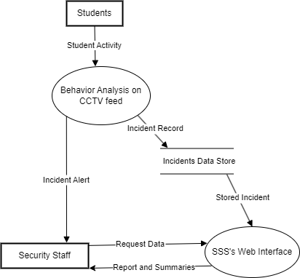
Data Flow Diagram Level 1
Notes:
Helps developers and analysts understand how data flows within each major process.

Slide 12
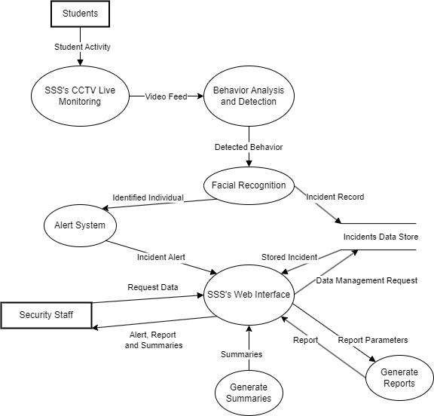
Data Flow Diagram Level 2
Notes:
Assists in designing the implementation details of each process.

Slide 13
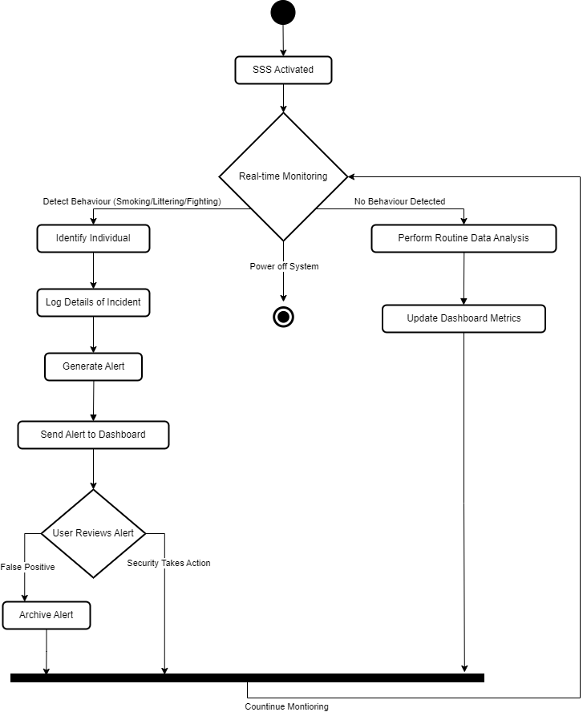
Activity Diagram
Notes:
Used to show flow of one activity/action state to another in the system
Arrows represent control flow

Slide 14
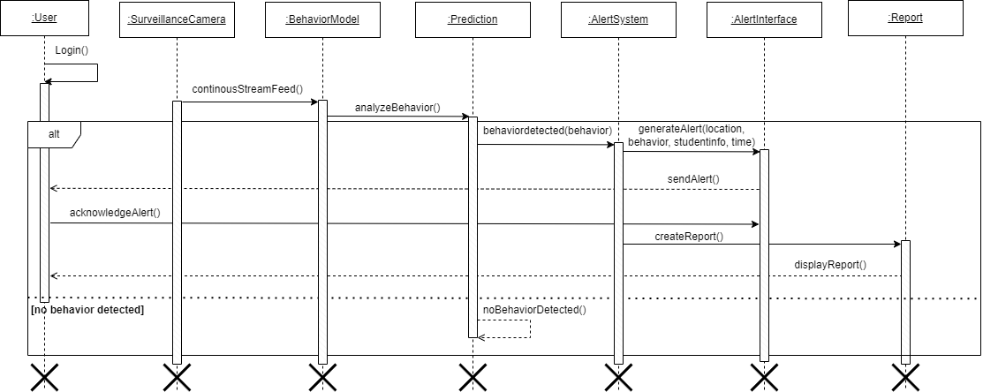
Sequence Diagram
Notes:
Sequence Diagram is the interaction between the objects of the system. Overall interaction between the system object takes place here.
Simple Line with filled arrow head is the message that the any object/user is sending to another object
Dashed Line with arrow is the response generated in turn of the request that user/object did from the current object.

Slide 15
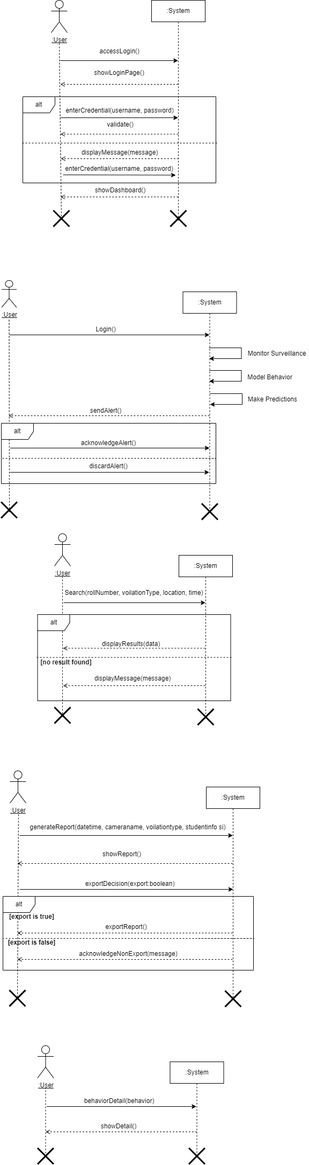
System Sequence Diagram
Login SSD
Notes:
System Sequence Diagrams are commonly used during the early stages of system analysis and design to model and document the interactions between actors and the system

Slide 16
System Sequence Diagram
Address Alert SSD
Notes:
System Sequence Diagrams are commonly used during the early stages of system analysis and design to model and document the interactions between actors and the system

Slide 17
System Sequence Diagram
Search And Filter SSD
Notes:
System Sequence Diagrams are commonly used during the early stages of system analysis and design to model and document the interactions between actors and the system

Slide 18
System Sequence Diagram
Generate Report SSD
Notes:
System Sequence Diagrams are commonly used during the early stages of system analysis and design to model and document the interactions between actors and the system

Slide 19
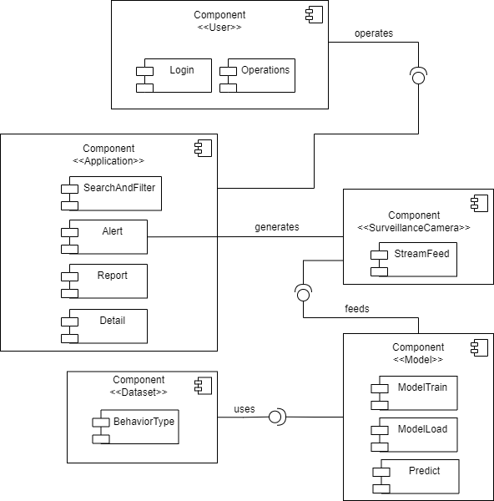
Component Diagram
Notes:
A component diagram is a type of structural diagram in the Unified Modeling Language (UML) used to visualize the components of a system and their relationships.
Inside the component there are the modules like in application we have Alert,SearchAndFilter
OO programming approach, the component diagram allows a senior developer to group classes together based on common purpose so that the developer and others can look at a software development project at a high level.

Slide 20
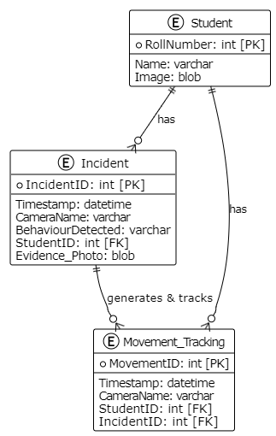
Entity Relationship Diagram

Slide 21
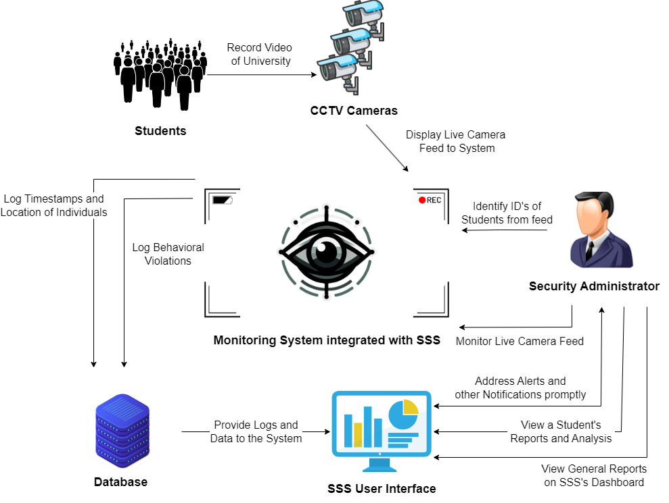
High Level Diagram

Slide 22
Commitment
Login
Identifying Individuals (Facial Recognition)
Manage Data
View Data Summary
Notes:
Generalization: smoking behavior (child inherits) and adds to parent detect behavior
Include: included use case detect behavior never stands alone, it occurs because address alert is a greater significant use case
Extend: base can stand alone (view data) but extension can be done on its behavior under certain conditions by another use case (search and filter)

Slide 23
Thank You

